Slide 1
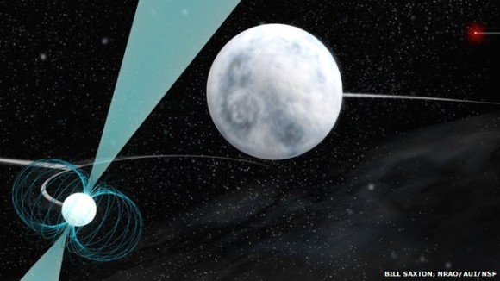
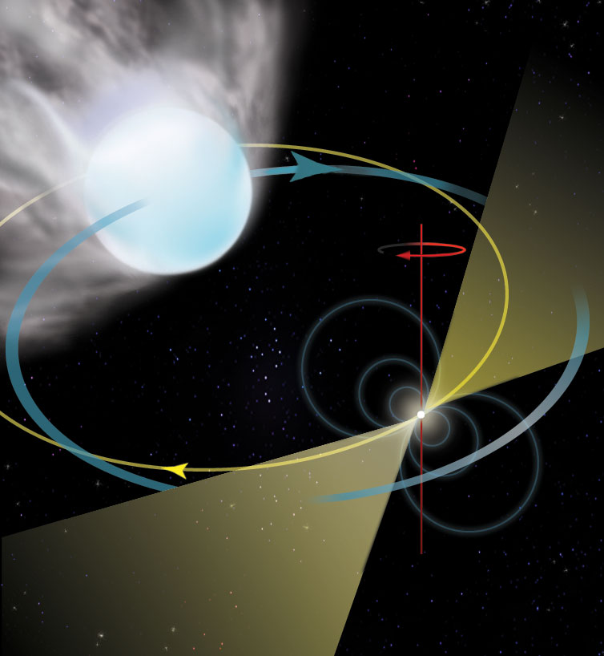
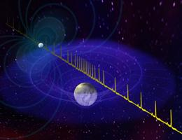

Other Science with Pulsar Timing Arrays
Maura McLaughlin (WVU)
IPTA Student Workshop June 14 2019

Slide 2
Aka…Our Secondary Science is Better Than Your Primary Science
Maura McLaughlin (WVU)
IPTA Student Workshop June 14 2019

Slide 3
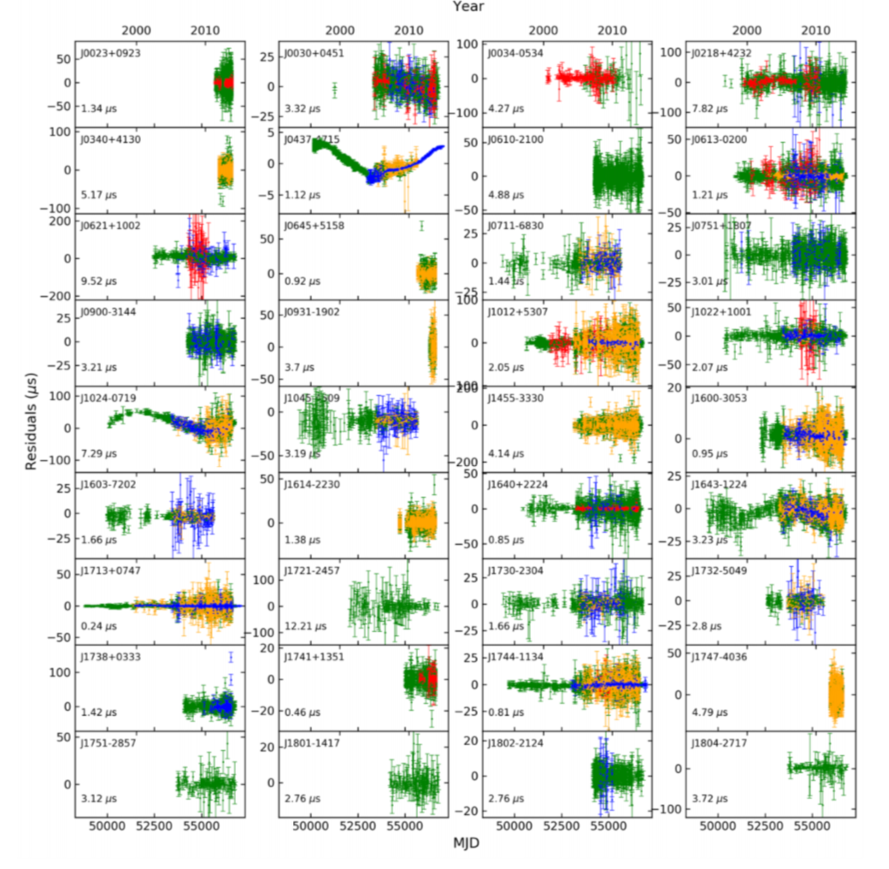
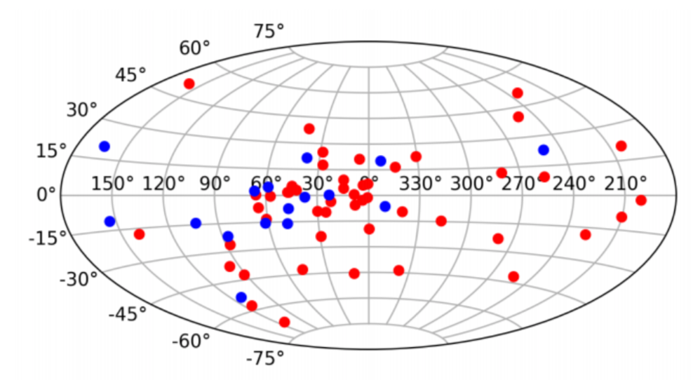
The IPTA Second Data Release
Includes 65 millisecond pulsars timed by NANOGrav, EPTA, and PPTA
“The International Pulsar Timing Array: Second data release”, Perera et al. in preparation
IPTA Student Workshop June 14 2019
Notes:
Pulsars, some going back 20 years, lots of different telecopes.

Slide 4
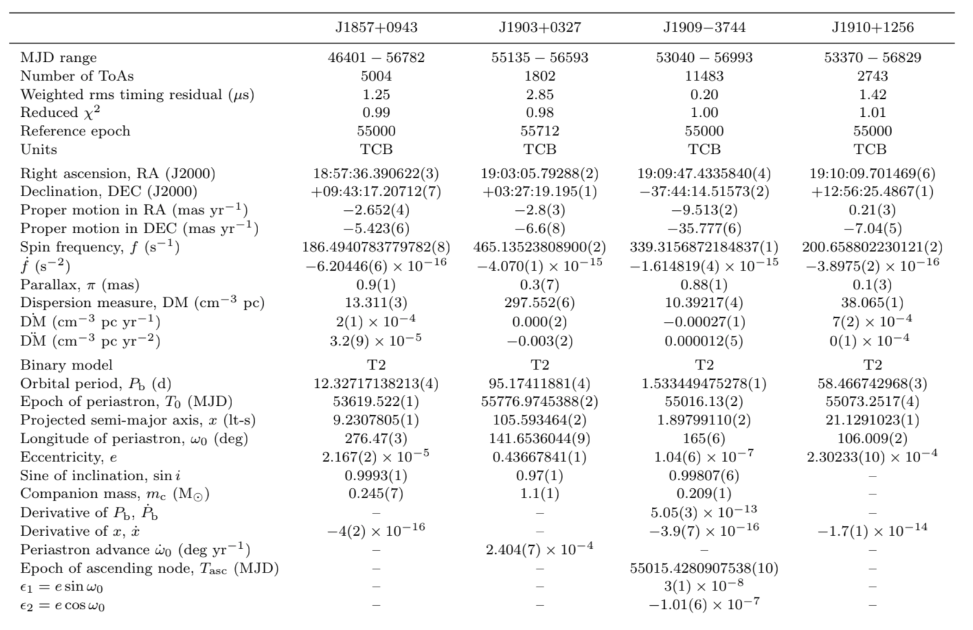
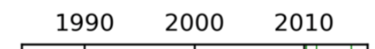
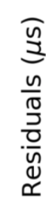
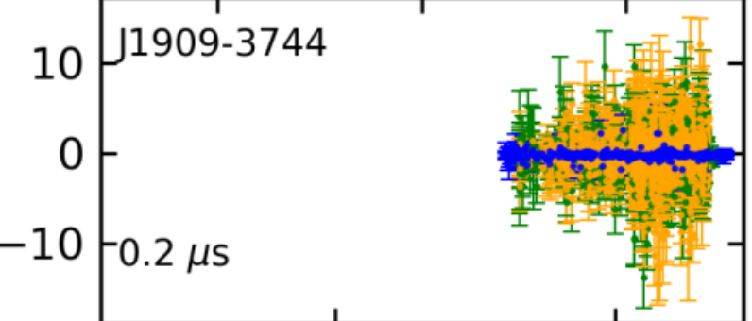
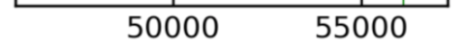
An Example Par File
Best timed pulsar is J1909-3744, observed by all three PTAs.
IPTA Student Workshop June 14 2019
Notes:
Nearby, period of 3 ms, binary of orbit 1.5 days with a low mass companion. For other applications, we’ve been looking at these parameters as necessary things to fit in order to get to gravitational waves. But there is lots of science in these things! Let’s look at some of these parameter.

Slide 5
Let’s look at the timing parameters…
Caveats:
- MSPs only
- non-GW science only
- necessarily biased selection of papers and applications
IPTA Student Workshop June 14 2019
Notes:
ASK QUESTIONS!

Slide 6
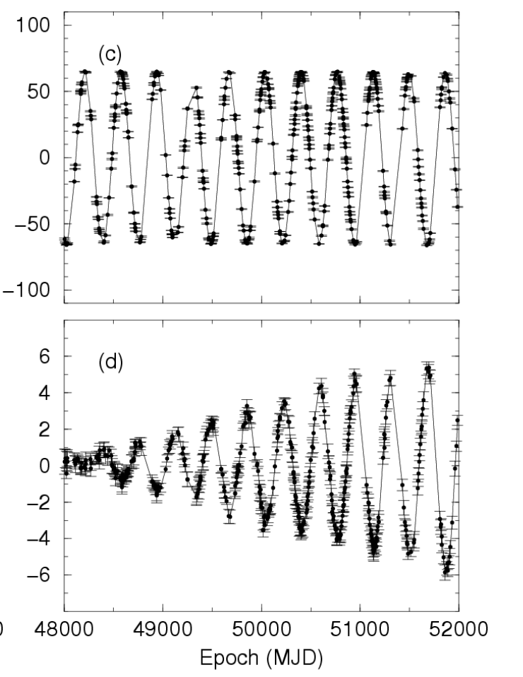
Astrometric Parameters
Position
Proper Motion
IPTA Student Workshop June 14 2019
Notes:
Skip over first few lines…astrometric parameters.

Slide 7
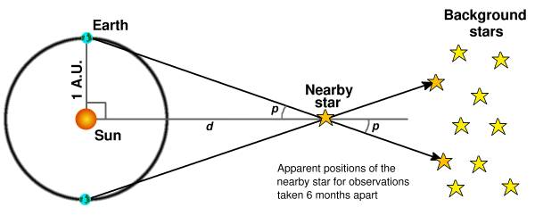
Astrometric Parameters: Distances
Of the 65 IPTA pulsars, 32 have significant parallax measurements
IPTA Student Workshop June 14 2019
Notes:
Going to start with parallax because it is super important. Parallax is the apparent shift in position when … Parallax in arcseconds is 1/ the distance in parsecs. So this pulsar with a parallax of about a milliarcsecond has a distance of about 1 kpc.
WHY???

Slide 8
Astrometric Parameters: Distances
Necessary for pulsar population studies, interpretation of luminosities and spectra from multi-wavelength observations, velocity measurements, GR effects, etc.
IPTA Student Workshop June 14 2019

Slide 9
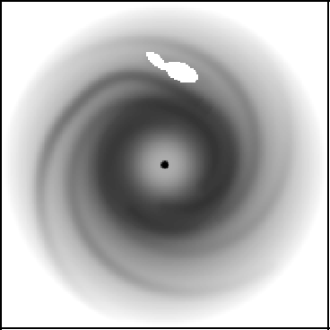
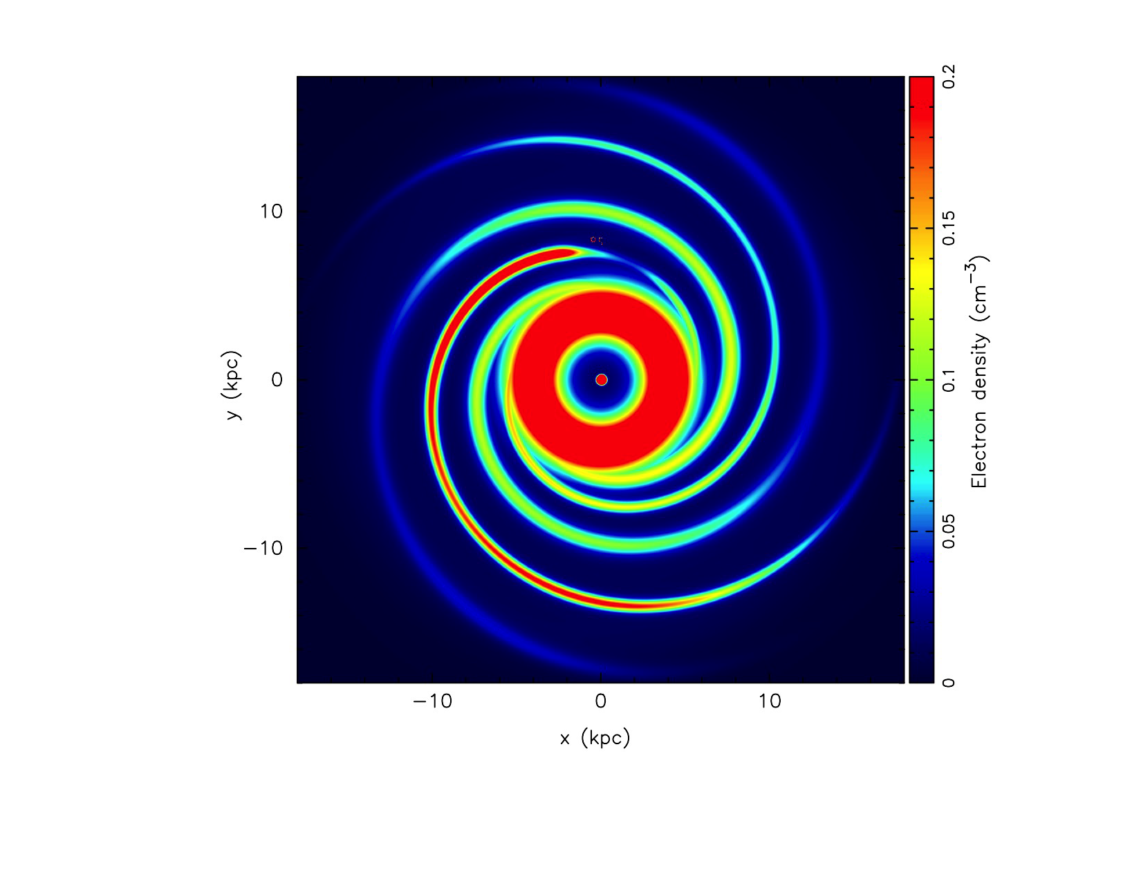
Astrometric Parameters: Distances
Better electron density models
YWM16 Model
NE2001 Model
Can use these models to “bootstrap” distances to pulses w/o parallax measurements. Pulsar distances and DMs are necessary for calibration.
IPTA Student Workshop June 14 2019
Notes:
Models of the electron density are important! Both to understand the gas in the galaxy and also to get distances w/o parallax measurements.
Will come back to parallax!

Slide 10
Astrometric Parameters: Positions
All pulsars have position measurements!
Positions can be known to sub-microarcseconds!
IPTA Student Workshop June 14 2019

Slide 11
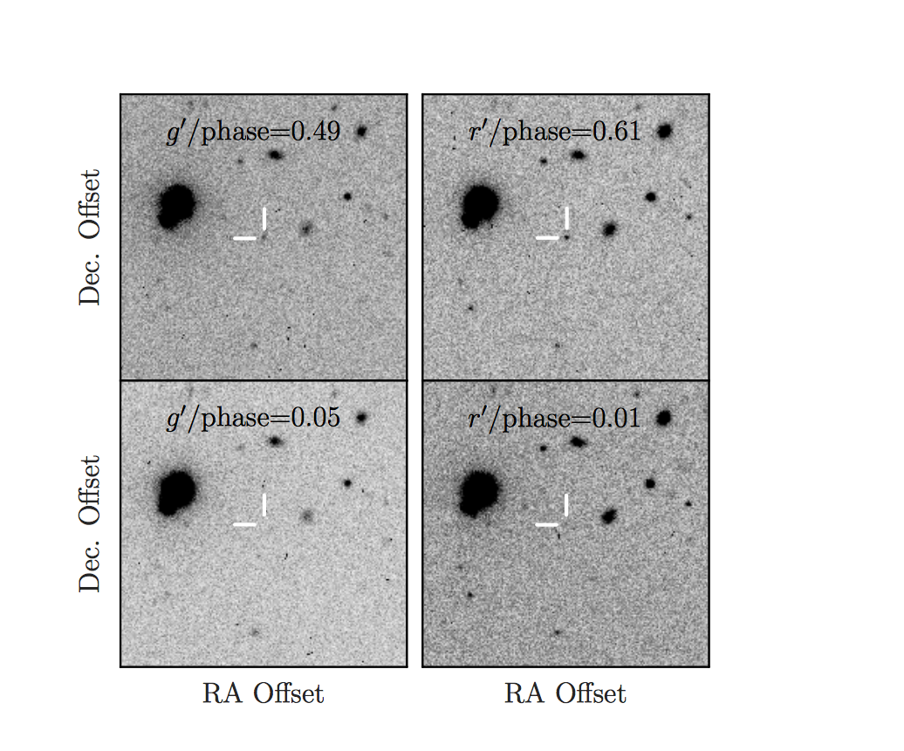
Astrometric Parameters: Positions
Companion observations
Observations of PSR J0636+5128 allow measurement of companion mass
(0.017 solar masses) and radius (0.008 Earth radii).
Density is approximately 54(26) g cm⁻³.
Parallax necessary for interpretation!
“A Dense Companion to the Short-Period Millisecond Pulsar Binary PSR J0636+5128” Kaplan et al. 2018, ApJ, 864, 15
IPTA Student Workshop June 14 2019
Notes:
Radio positions are initially very poor – maybe 10s of arcminutes. Lots of stars! Good positions allow searches for compainion. Lightcurve modeling! Pulsar irradiating companion!

Slide 12
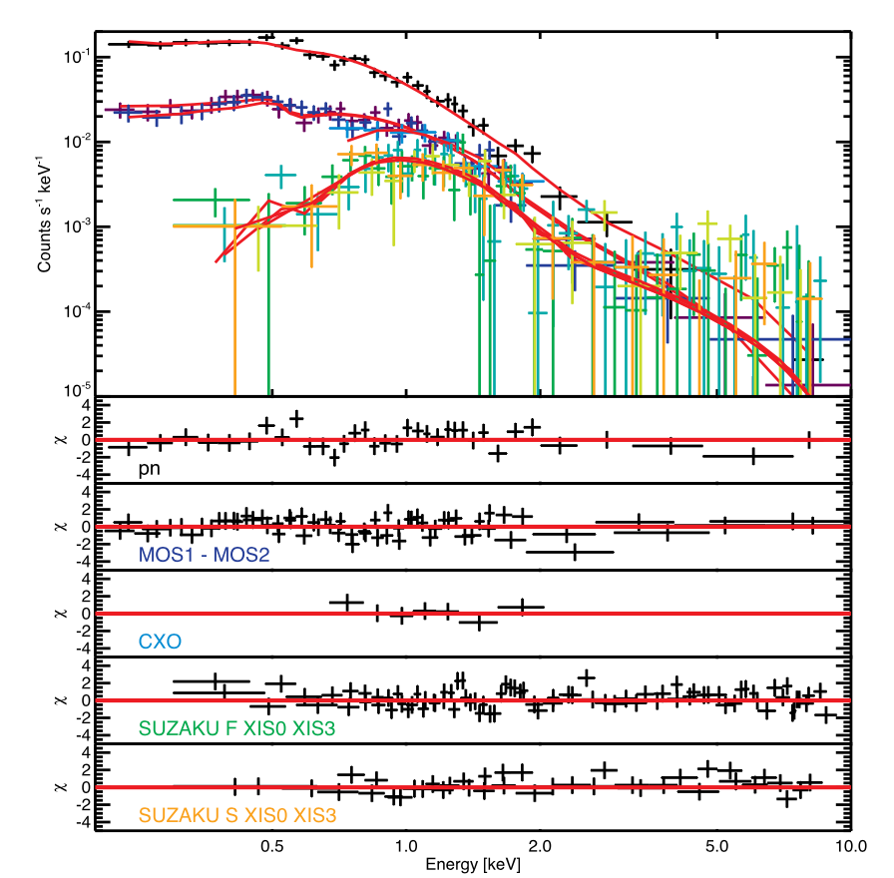
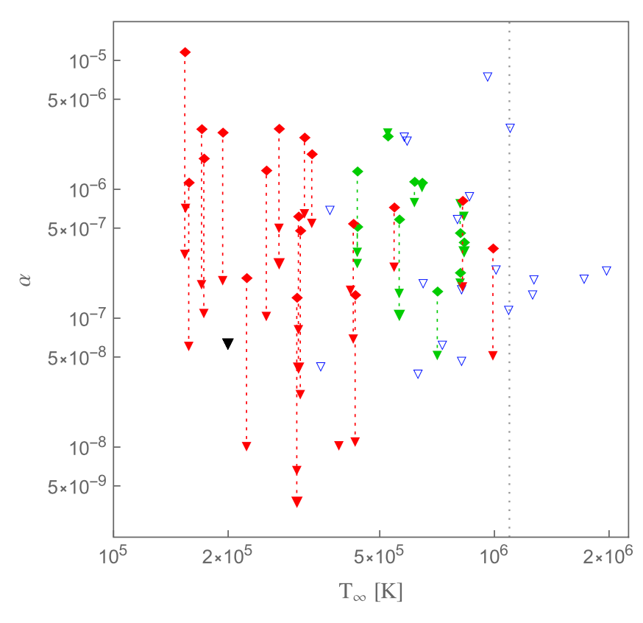
Astrometric Parameters: Positions
Multi-wavelength observations
Used to place constraints on the r-mode amplitude for PSR J1231-1411.
“X-ray bounds on the r-mode amplitude in millisecond pulsars”
Schwenzer et al. 2017, ApJ, 466, 2560
IPTA Student Workshop June 14 2019
Notes:
R modes are a type of oscillation that heat the neutron star. Open triangles are LMXB.

Slide 13
Astrometric Parameters: Proper Motions
Of the 65 MSPs, 25 and eight have significant proper motion measurements in RA and DEC.
IPTA Student Workshop June 14 2019
Notes:
Parallaxes in mas – these in mas/year.

Slide 14
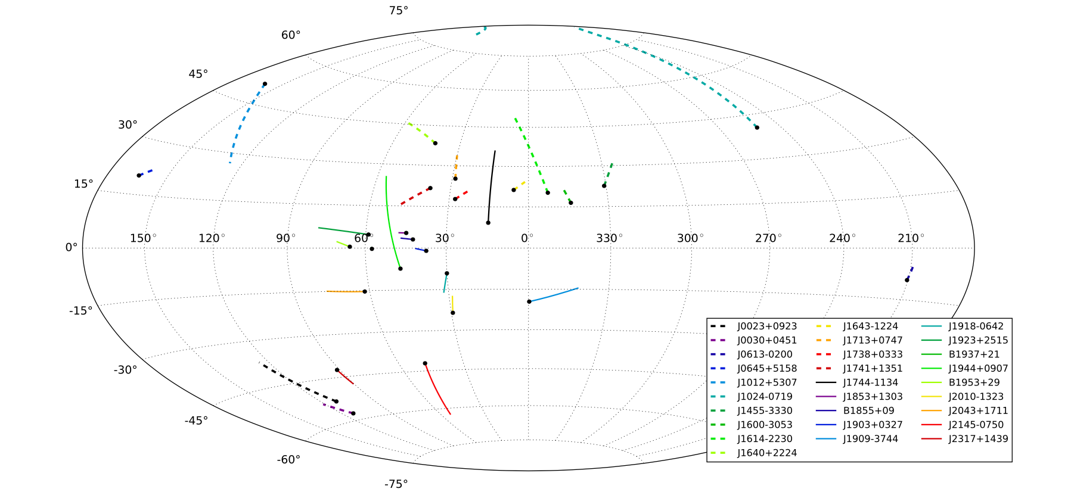
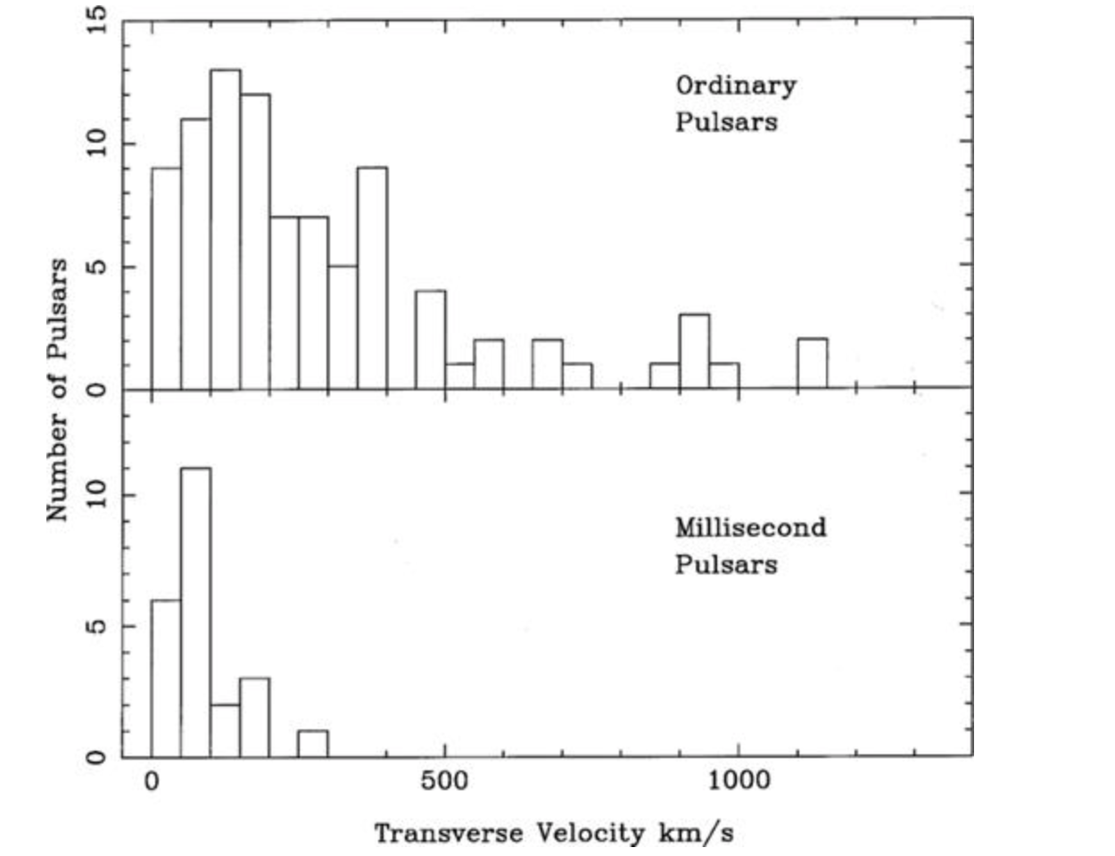
Astrometric Parameters: Proper Motions
MSP proper motions are fairly random, like other old populations, and lower than normal pulsars.
Can we constrain kick velocities?
Dependence of kick on companion type?
“The NANOGrav Nine-year Data Set: Astrometric Measurements of 37 Millisecond Pulsars” Matthews et al. 2016, ApJ, 818, 92
Can we constrain kick velocities?
Dependence of kick on type of supernova?
“Millisecond pulsar velocities” Toscano et al. 1999, MNRAS, 307, 4
IPTA Student Workshop June 14 2019
Notes:
Paths over past 5 million years! Distances necessary! More massive

Slide 15
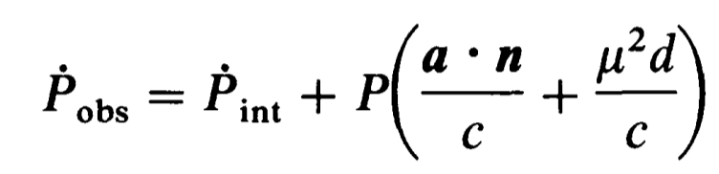
Astrometric Parameters: Proper Motions
Accurate proper motions and distances allow corrections of period derivatives for Doppler effects to get intrinsic period derivatives – called the Shklovskii effect.
IPTA Student Workshop June 14 2019
Notes:
Always higher! Really important!

Slide 16
Spin and Spin-Down Parameters
Measured for all pulsars!
IPTA Student Workshop June 14 2019

Slide 17
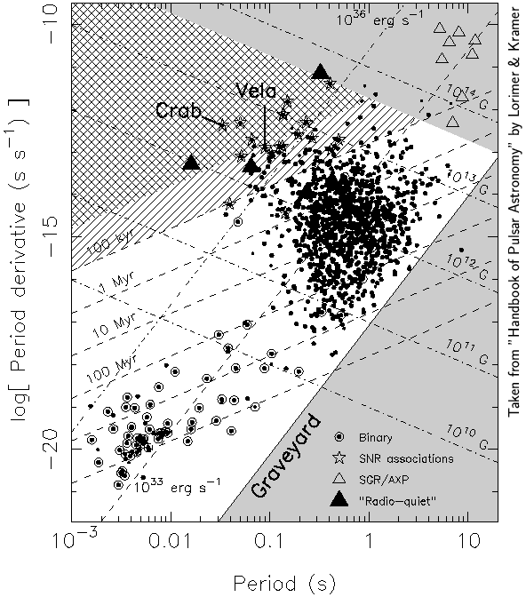
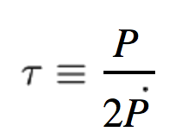
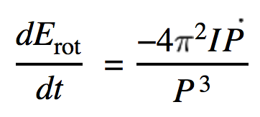
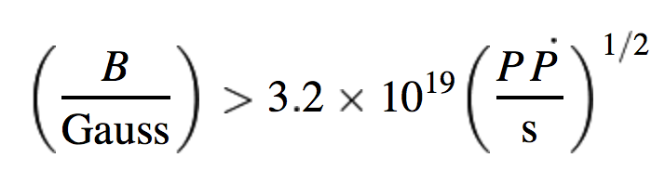
Spin and Spin-Down Parameters
What are the fundamental properties of pulsars?
How do they evolve?
IPTA Student Workshop June 14 2019
Notes:
Magnetic field. Assumes an orthogonal rotator.

Slide 18
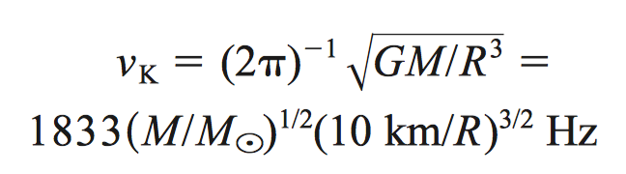
Spin and Spin-Down Parameters
Spin period gives us an equation of state constraint.
Most realistic EOS give maximum frequencies of ~ 1 kHz.
Fastest rotating pulsar spins at 716 Hz. Why?
IPTA Student Workshop June 14 2019
Notes:
Material would start getting ripped off the surface by centrifugal forces! Spin-up? Gravitational damping? Want to understand! Let’s continue on our tour.

Slide 19
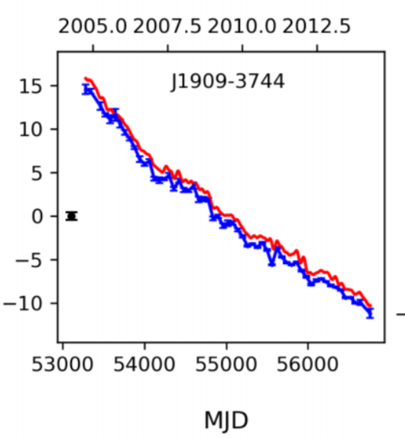
Dispersion Measure
IPTA Student Workshop June 14 2019

Slide 20
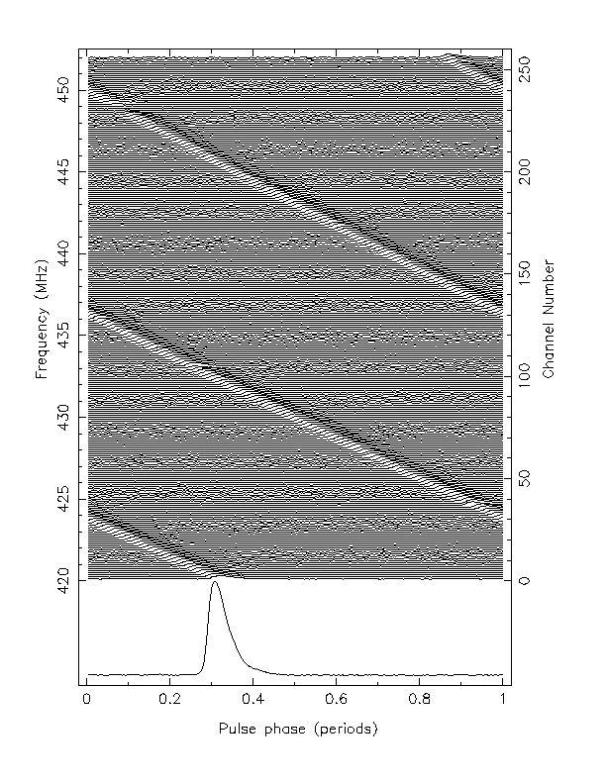
Dispersion Measure
DM is measured for all pulsars.
First and second
derivatives
measured for 40
and 32 of the 65.
IPTA Student Workshop June 14 2019

Slide 21
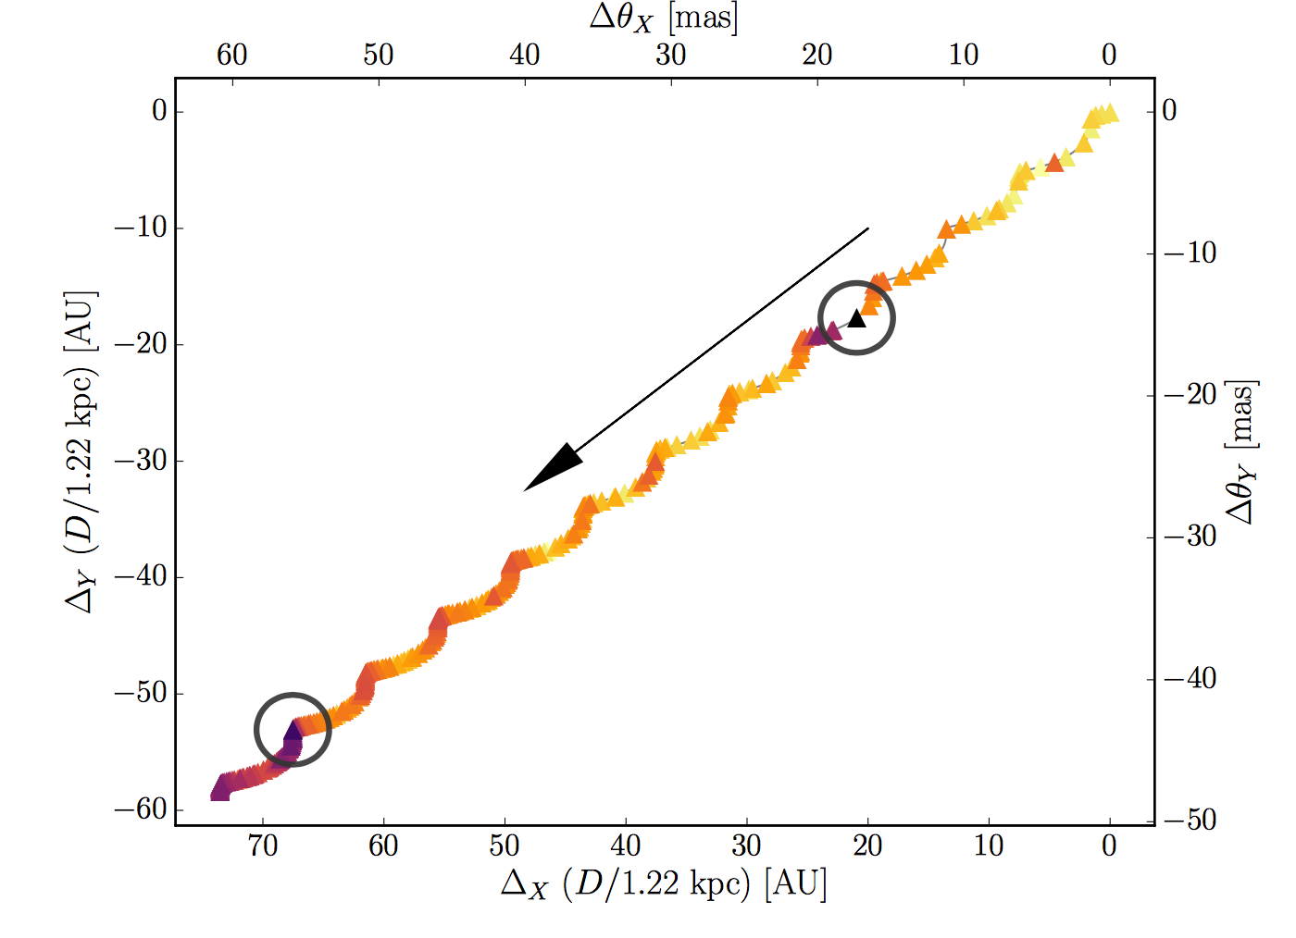
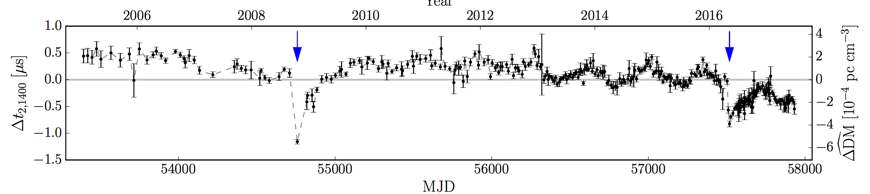
Dispersion Measure
We measure linear, annual, and other DM variations.
Can constrain structure and homogeneity of the ISM.
“A Second Chromatic Timing Event of Interstellar Origin toward PSR J1713+0747”
Lam et al. 2018, ApJ, 861, 132
IPTA Student Workshop June 14 2019

Slide 22
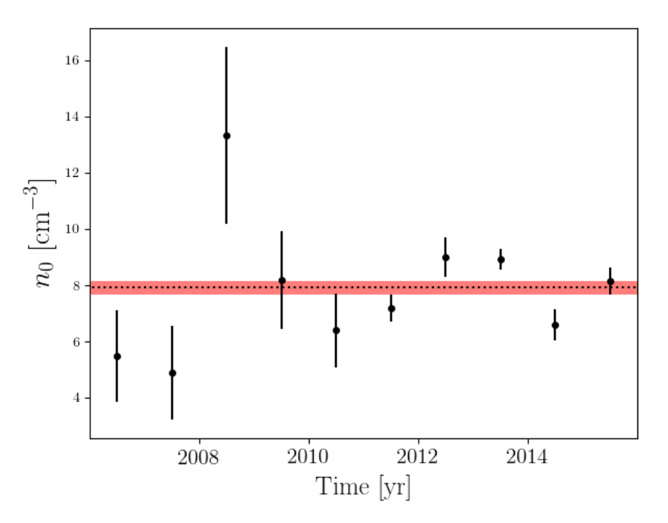
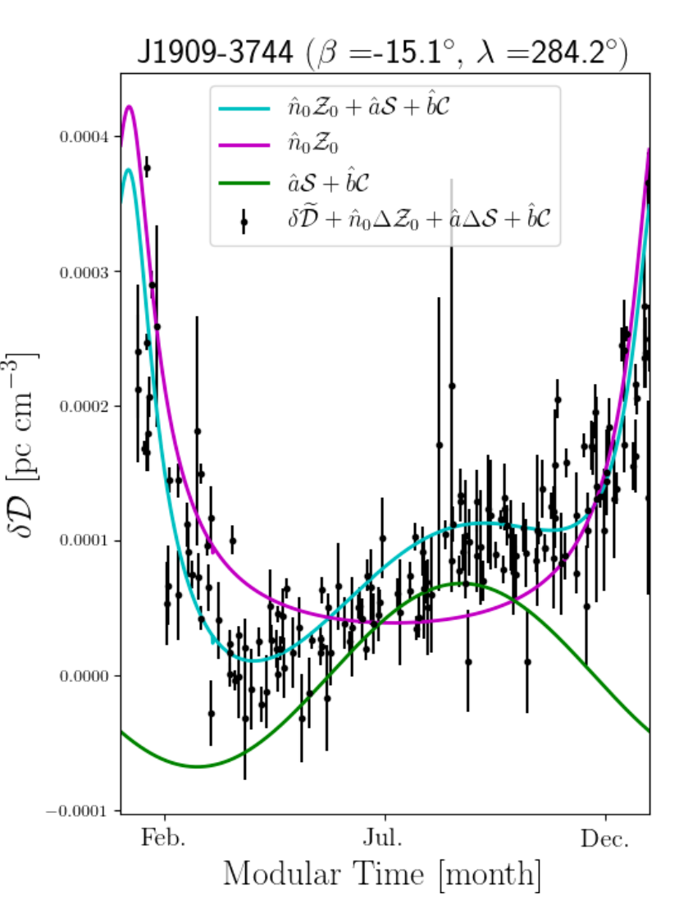
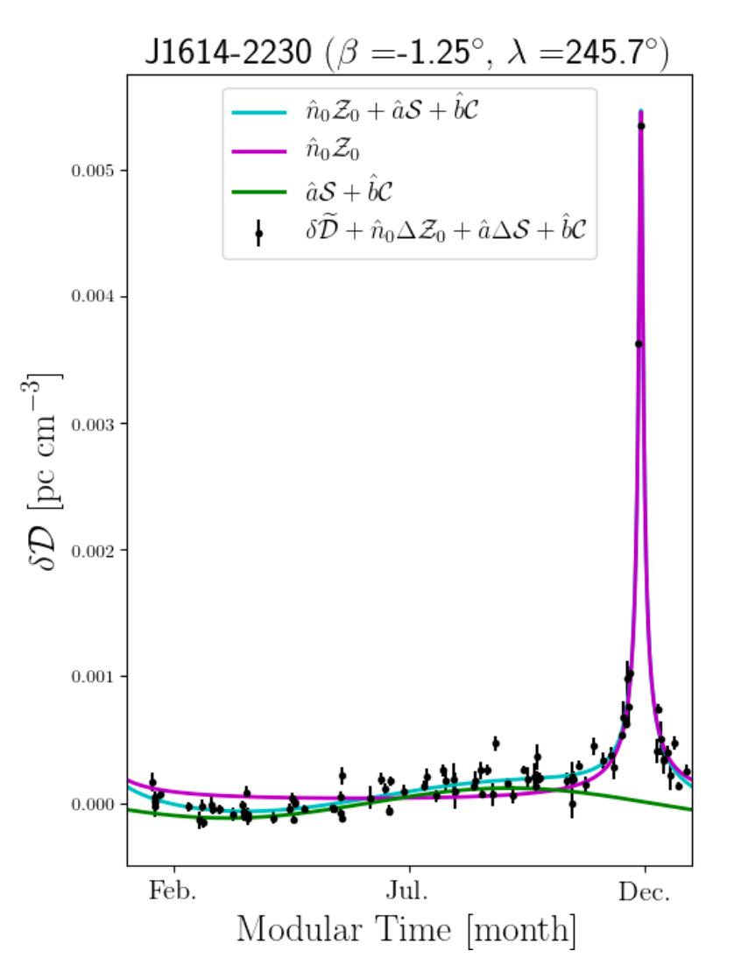
Dispersion Measure
Probing the shape and density of the solar wind
“The NANOGrav 11-year data set: solar wind sounding through pulsar timing” Madison et al. 2018, ApJ, 861, 132
IPTA Student Workshop June 14 2019

Slide 23
Binary Parameters
Of the 65 MSPs, 44 are in binary systems with white dwarf stars.
We measure five Keplerian orbital parameters for each.
And Post-Keplerian parameters for some.
IPTA Student Workshop June 14 2019

Slide 24
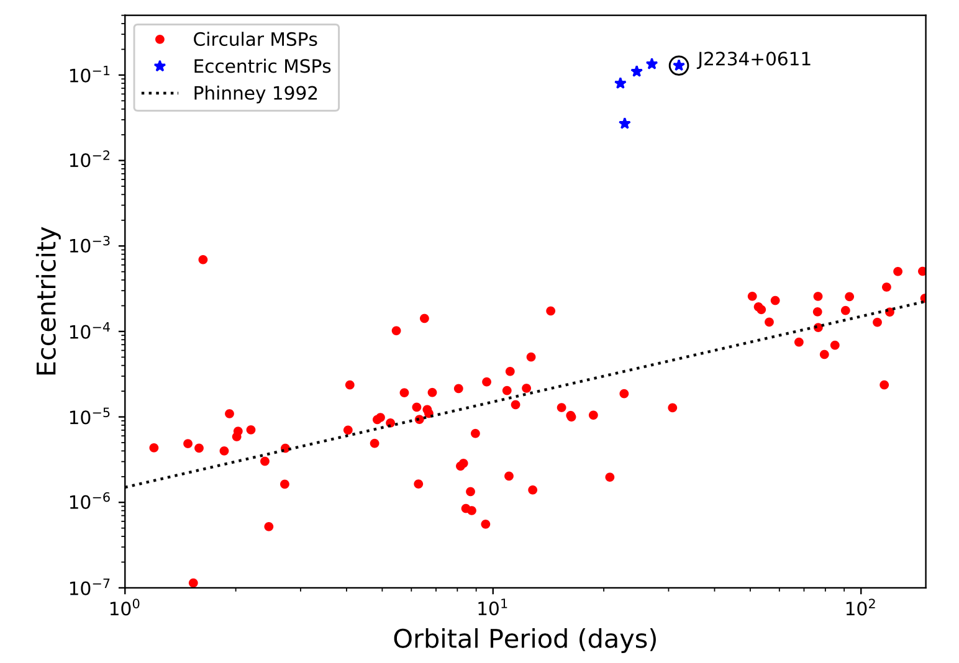
Binary Parameters:
Keplerian Parameters
Binary parameters help us understand the recycling process.
Why are some MSPs in eccentric orbits?
“PSR J2234+0611: A New Laboratory for Stellar Evolution”
Stovall et al. ApJ, 2019, 870, 74
IPTA Student Workshop June 14 2019
Notes:
Material ejected from the companion during H shell burning. Dynamical interactions with the disk.

Slide 25
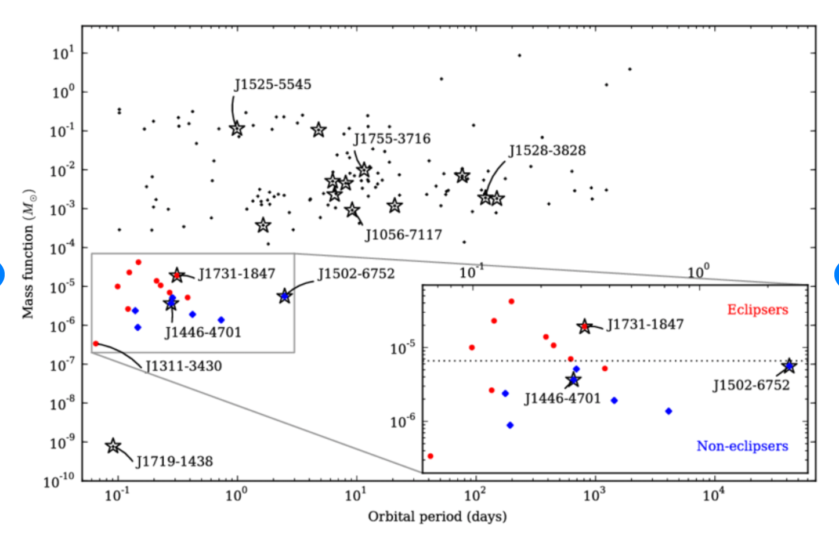
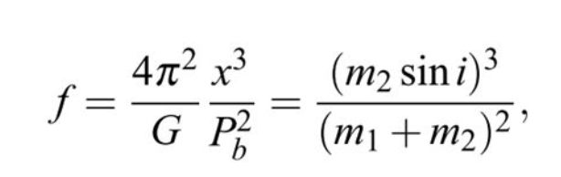
Binary Parameters:
Keplerian Parameters
Binary parameters help us understand the recycling process.
What pulsars are likely to have eclipses?
“The High Time Resolution Universe Pulsar Survey X: Discovery of four millisecond pulsars and updated timing solutions of a further 12”
Ng et al. MNRAS, 2014, 439, 2
IPTA Student Workshop June 14 2019
Notes:
Material ejected from the companion during H shell burning. Dynamical interactions with the disk.

Slide 26
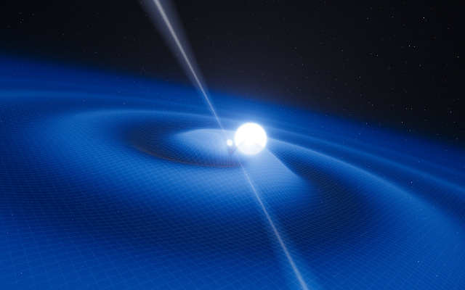
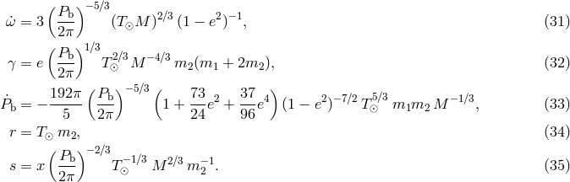
Binary Parameters:
Post-Keplerian Parameters
Of the 44 binary MSPs, 10 pulsars have orbital period derivative measurements.
IPTA Student Workshop June 14 2019

Slide 27
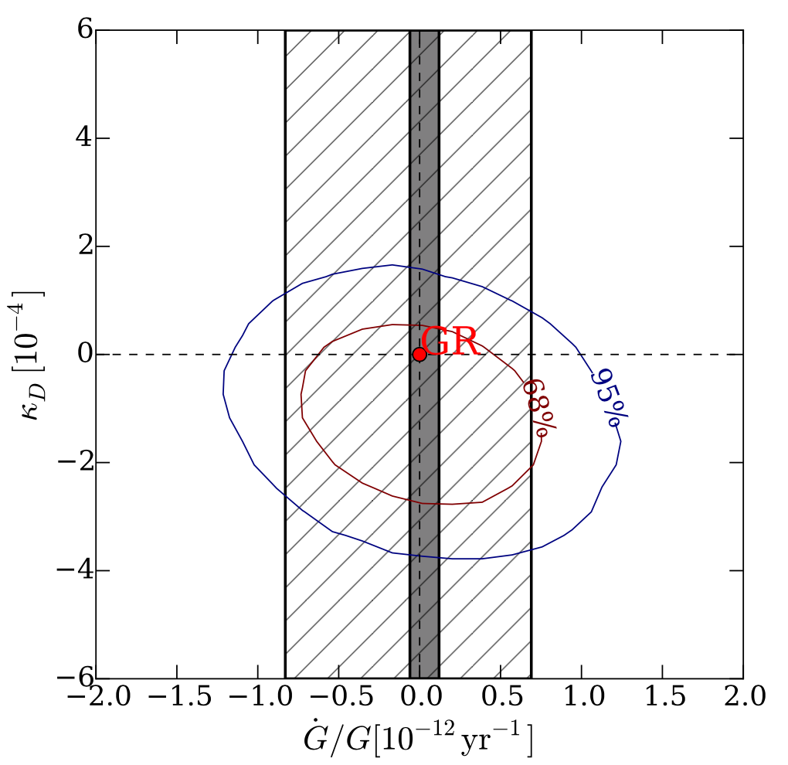
Binary Parameters:
Post-Keplerian Parameters
Time-varying gravitational constant would lead to time-varying orbital period.
“Tests of gravitational symmetries with pulsar binary J1713+0747”, Zhu et al. 2019, 482, 3249
IPTA Student Workshop June 14 2019

Slide 28
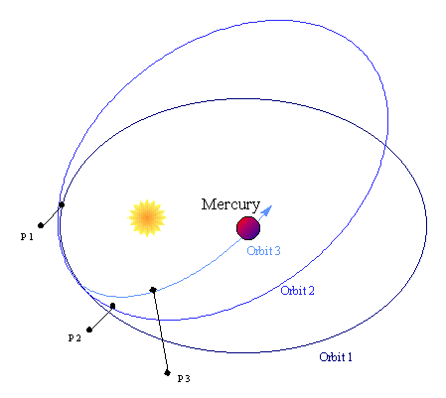
Binary Parameters:
Post-Keplerian Parameters
Six pulsars have measurable periastron advance (not 1909!)
IPTA Student Workshop June 14 2019
Notes:
90 degrees aligned with earth

Slide 29
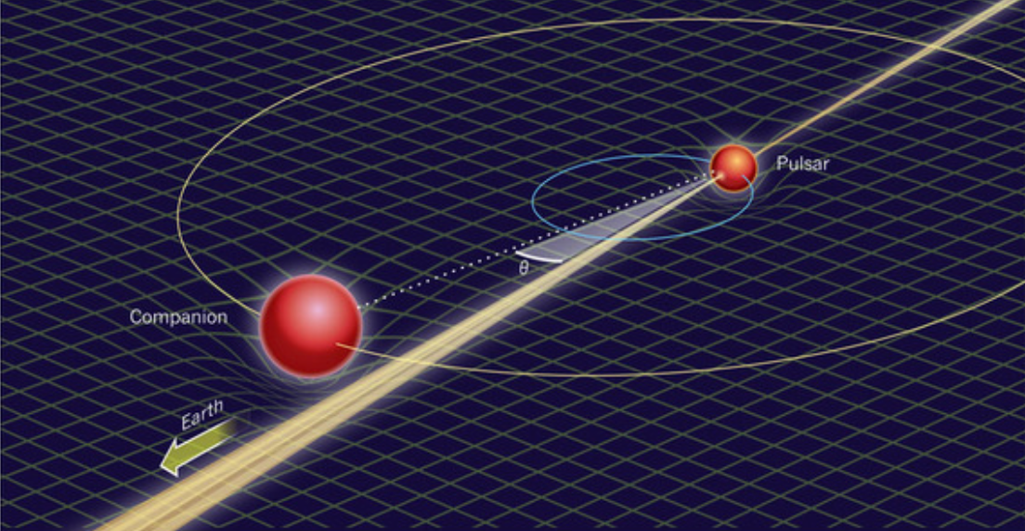
Binary Parameters:
Post-Keplerian Parameters
Of the 44 binaries, 14 have Shapiro delay measurements
IPTA Student Workshop June 14 2019

Slide 30
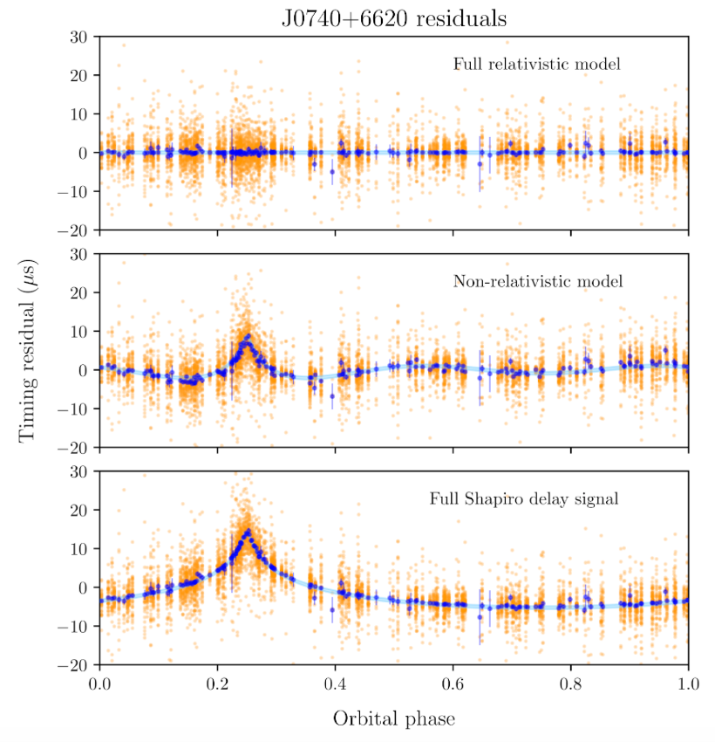
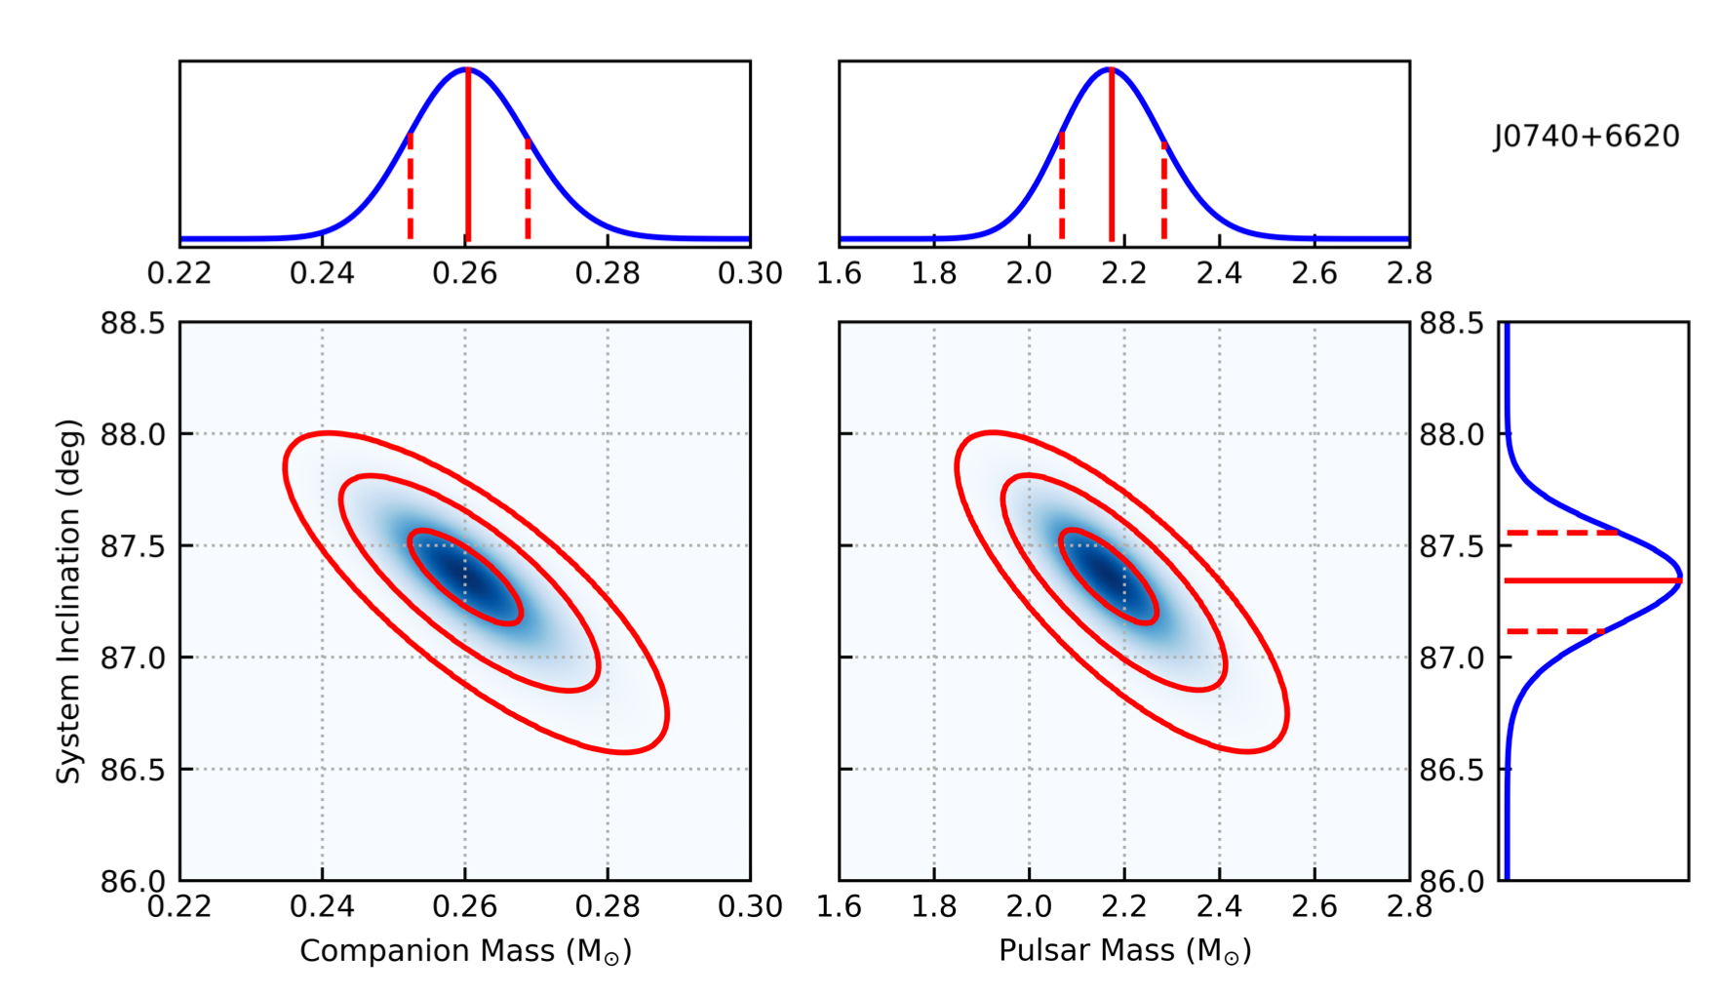
Binary Parameters:
Post-Keplerian Parameters
PSR J0740+6620 is 2.17(10) masses
“A very massive neutron star: relativistic Shapiro delay measurements of PSR J0740+6620”
Cromartie et al. Nature Astronomy Submitted
IPTA Student Workshop June 14 2019
Notes:
Explain range and shape!

Slide 31
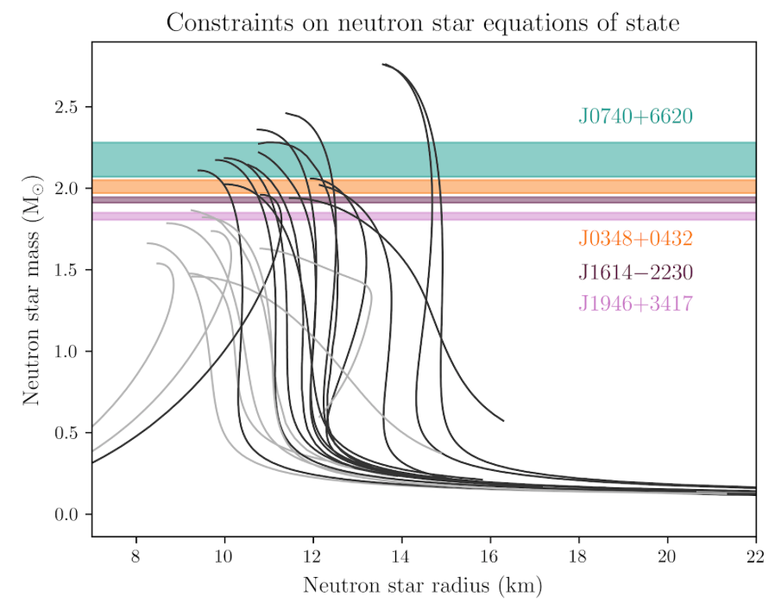
Binary Parameters:
Post-Keplerian Parameters
Starting to rule out many equations of state!
IPTA Student Workshop June 14 2019
Notes:
Grey are more strange EOS!

Slide 32
Binary Parameters:
Post-Keplerian Parameters
The Double Pulsar!
One more PK parameter for gravitational redshift and time dilation, but not generally measurable for NS-WD binaries.
Kramer et al. in prep
IPTA Student Workshop June 14 2019

Slide 33
Binary Parameters:
Post-Keplerian Parameters
The Double Pulsar!
One more PK parameter for gravitational redshift and time dilation, but not generally measurable for NS-WD binaries.
Soon, correction to precession of periastron from spin orbit coupling! Proportional to moment of inertia.
Kramer et al. in prep
IPTA Student Workshop June 14 2019

Slide 34
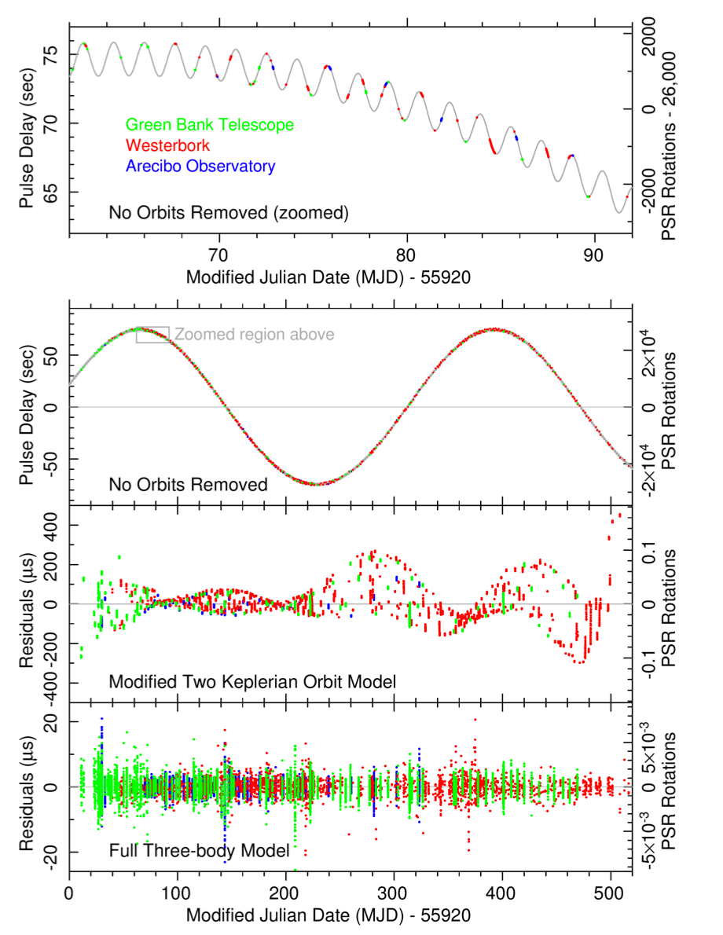
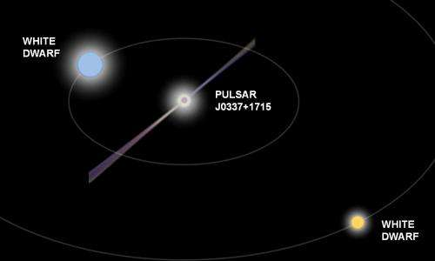
Binary Parameters:
Triple System
Inner binary of 1.6 days and outer binary of 327 days
“A millisecond pulsar in a stellar triple system”
Ransom et al. 2014, Nature, 505, 520
IPTA Student Workshop June 14 2019
Notes:
0.2 and 0.4 solar mass objects!

Slide 35
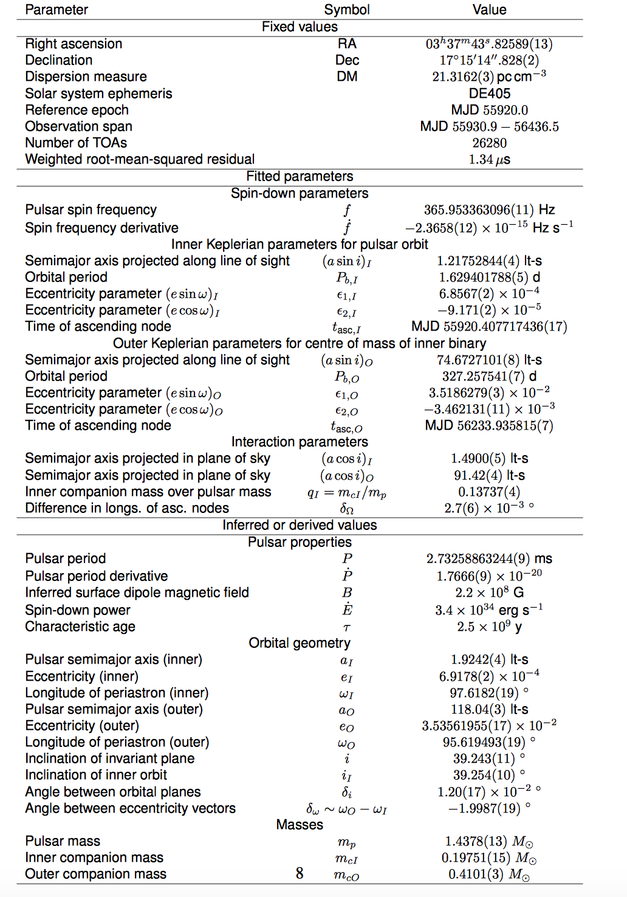
Binary Parameters:
Triple System
Inner binary of 1.6 days and outer binary of 327 days
“A millisecond pulsar in a stellar triple system”
Ransom et al. 2014, Nature, 505, 520
IPTA Student Workshop June 14 2019
Notes:
0.2 and 0.4 solar mass objects!

Slide 36
Binary Parameters:
Triple System
The Strong Equivalence Principle
The gravitational motion of a small test body depends only on its initial position in spacetime and velocity, and not on its constitution
The outcome of any local experiment (gravitational or not) in a freely falling laboratory is independent of the velocity of the laboratory and its location in spacetime.
Accelerations of pulsar and inner white dwarf differ by
< 2 x 10⁻⁶.
Best test of the strong equivalence principle!
“Universality of free fall from the orbital motion of a pulsar in a stellar triple system”
Archibald et al. 2018, Nature, 559
IPTA Student Workshop June 14 2019
Notes:
0.2 and 0.4 solar mass objects!

Slide 37
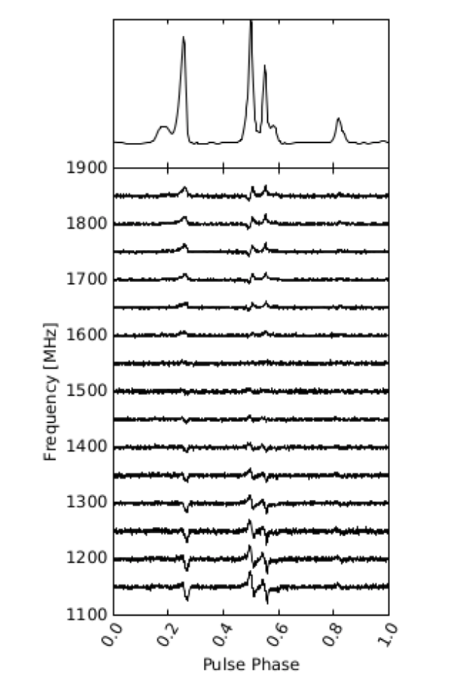
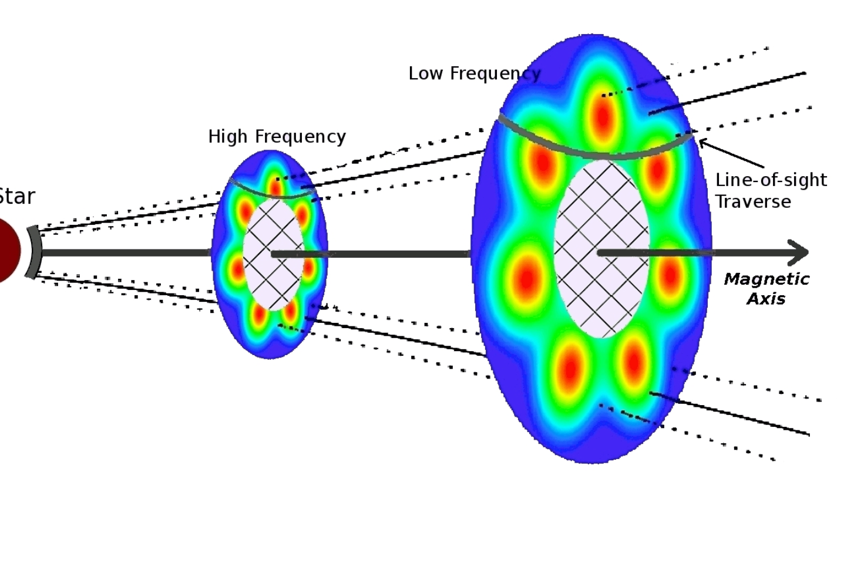
Stuff not in the par file: Pulse Profile Evolution
Pulse profile evolution for PSR J1832-0836.
Mann et al. 2013, ApJS, 12
Shapiro-Albert et al. in prep
IPTA Student Workshop June 14 2019

Slide 38
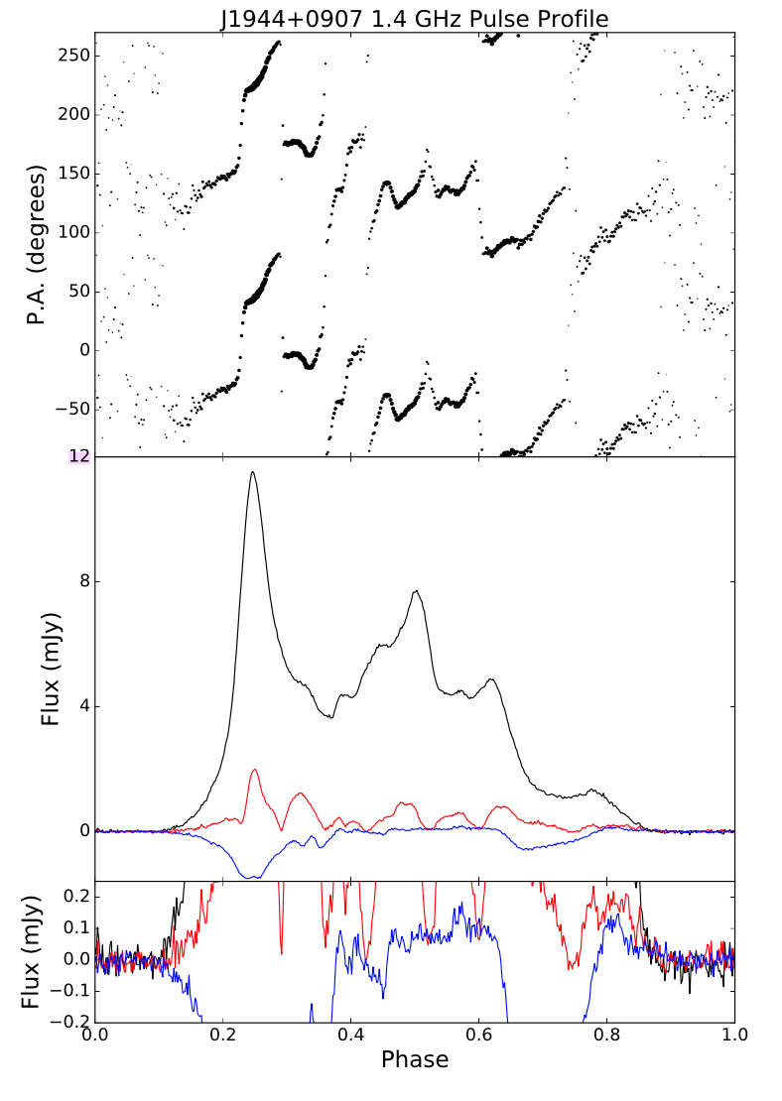
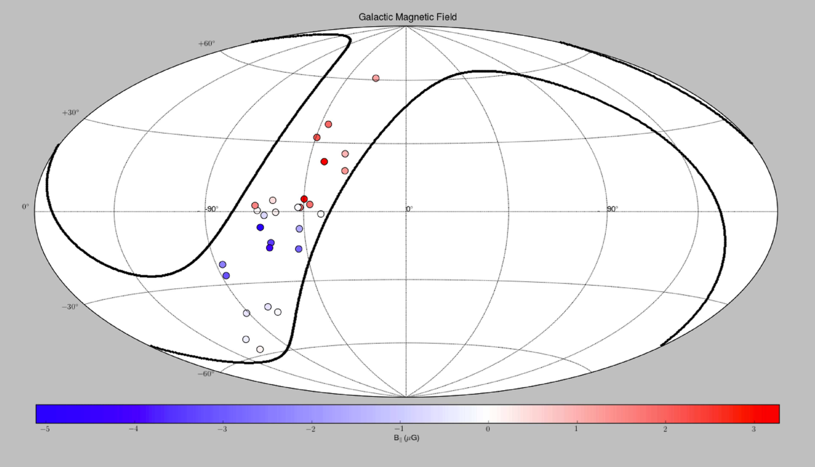


Stuff not in the par file: Polarization
Can constrain emission mechanisms, pulsar geometry, and Galactic B fields!
“The NANOGrav 11-year data set: Arecibo Observatory polarimetry and pulse microcomponents"
Gentile et al. 2018, ApJ, 862, 1
IPTA Student Workshop June 14 2019
Notes:
Position angle is orientation of linear polarization. Faraday rotation – frequency dependent.

Slide 39


Stuff not in the par file: Noise Parameters!
Lots of info about intrinsic and extrinsic properties
Red noise contributions can constrain EOS
“The NANOGrav Nine-year Data Set: Excess Noise in Millisecond Pulsar Arrival Times”, 2017, ApJ, 834, 35
IPTA Student Workshop June 14 2019

Slide 40
Stuff not in the par file: Noise Parameters!
Lots of info about intrinsic and extrinsic properties
“The NANOGrav Nine-year Data Set: Excess Noise in Millisecond Pulsar Arrival Times”, 2017, ApJ, 834, 35
IPTA Student Workshop June 14 2019

Slide 41



Stuff not in the par file:
Scintillation
Shapiro-Albert et al. in prep
Can measure bandwidth and timescales, which relate to ISM structures and velocities
IPTA Student Workshop June 14 2019

Slide 42


Planetary Ephemerides
Pulsar timing arrays can be used to constrain masses of solar system objects!
“Studying the solar system with the International Pulsar Timing Array”, Cabellero et al., 2018, MNRAS, 481, 4
IPTA Student Workshop June 14 2019

Slide 43


Space Navigation!
SEXTANT can localize spacecraft to 10 miles through pulsar timing!
Observed four MSPs - J0218+4232, B1821-24, J0030+0451, and
J0437-4715 - over two days.
IPTA Student Workshop June 14 2019

